Slide 1


EXCEL
CAPSTONE
PROJECT
DILEEP PATTED

Slide 2

PROBLEM STATEMENT
THE SOURCE OF MY DATASET IS FROM IMDB MOVIE DATABASE. THE PROBLEM STATEMENTS I HAVE MENTIONED IN MY DASHBOARD ARE BUDGET FOR A MOVIE, REVENUE GENERATED BY A MOVIE, REVENUE FOR A LEAD ACTOR AND I HAVE FILTERED MOVIES BASED ON IMDB SCORE, COLOR AND B/W AND GENRE. I HAVE ALSO MENTIONED REVENUE COLLECTED AND BUDGET KEPT FOR DIFFERENT GENRES IN MY RESEARCH.

Slide 3
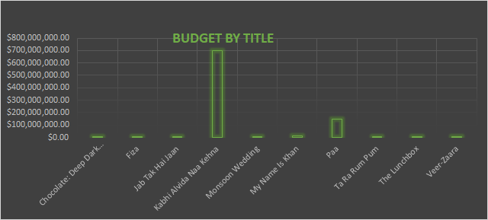
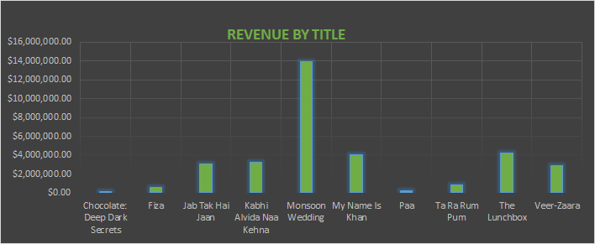
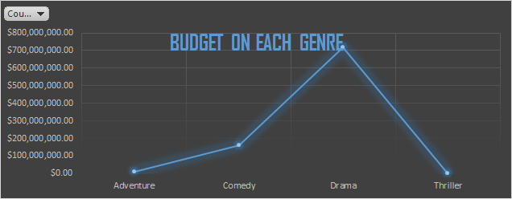
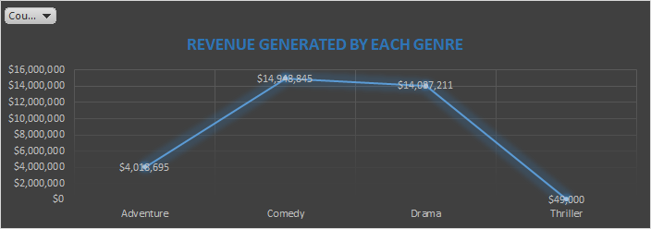
BASIC ANALYSIS

Slide 4
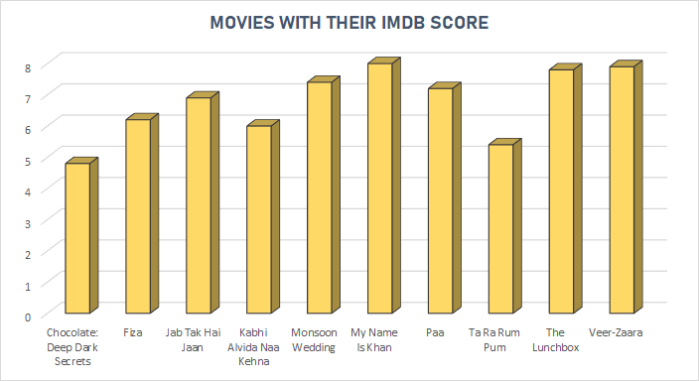
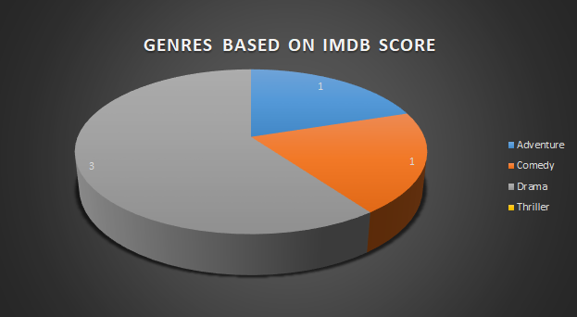

Slide 5
EXECUTIVE SUMMARY
THE PURPOSE OF CHOOSING IMDB DATASET IS TO KNOW WHAT TYPE OF GENRE/ACTOR DO PEOPLE PREFER WATCHING. THE MAIN ISSUE IN MOVIE INDUSTRY IS NEPOTISM AS STAR KIDS GET ALL THE ATTENTION OUTSIDERS ARE LEFT OUT SO BASED ON IMDB SCORE PEOPLE CAN FILTER THE BEST MOVIES TO BINGE-WATCH. THE CRITERIA I USED HERE IS I HAVE KEPT IMDB SCORE OF EACH MOVIE AND ALSO I HAVE KEPT THE REVENUE DIFFERENT STARS MAKE. SO HERE WE CAN UNDERSTAND THAT WE AREN’T SUPPORT THE TALENT NEWBIES / OUTSIDERS HAVE. BASED ON THE CRITERIA I HAVE SET WE GET TO SEE THAT STARKIDS OR THE BIG ACTORS WHO ALREADY ARE ESTABLISHED IN THIS INDUSTRY ARE GAINING MORE REVENUE THROUGH THEIR FILMS EVEN WHEN THEIR MOVIE’S IMDB SCORE IS LESSER COMPARED TO OUTSIDERS. SO MY RECOMMENDATION BASED ON MY RESEARCH WAS OUTSIDERS SHOULD GET EQUAL ATTENTION AS ESTABLISHED ACTORS AND THEIR HARDWORK AND TALENT MUST ALSO BE APPRECIATED.

Slide 6
https://drive.google.com/file/d/1nr8CjBaZeV1IpqEb9NGjoU2Y9hK5BTYG/view?usp=sharing
EXCEL FILE LINK
VIDEO LINK
https://drive.google.com/drive/folders/1Vi6urENlYTj6crAv4lmxF1gR0bxBqgfI?usp=sharing

